Slide 1
[171208]MSRC
김서진

Slide 2
Consistency and durability
Read/Write consistency
Manager keeps in-memory map of off-loads
Always knows where latest version is
Durability
Writes only after data hits the disk
Same guarantees as existing volumes
Transparent to applications

Slide 3
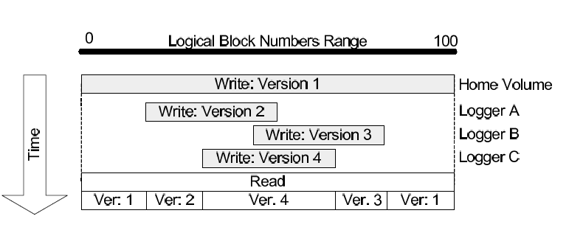
Consistency across loggers example

Slide 4
transient failures
disk failures
Loggers can recover locally
Scan the log
Managers recover from logger view
Logger view is persisted locally
Recovery: fetch metadata from all loggers
On clean shutdown, persist metadata locally
Manager recovers without network communication
Data on original volume: same as before
Typically RAID-1/RAID-5
Can remove from one failure
What about off-loaded data?
Ensure logger redundancy
>= manager
K-way logging for additional redundancy

Slide 5
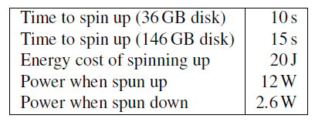
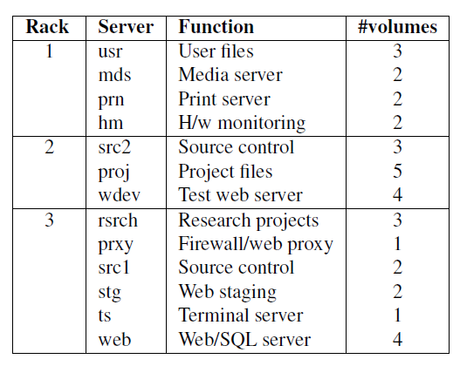
Evaluation
4 rack-mounted servers
- 1 Gbps network
- Seagate Cheetah 15k RPM disks
Single process per testbed server
- Trace replay app + managers + loggers
- In-process communication on each server
- UDP+TCP between servers

Slide 6
Workload
Open loop trace reply
Traced volumes larger than testbed
- Divided traced servers into 3 “racks”
Combined in post-processing
1 Week too long for real-time reply
- Chose best and worst days for off-load
Days with the most and least write-only time

Slide 7
Configurations
Baseline
Vanilla spin down(no off-load)
Machine-level off-load
- Off-load to any logger within same machine
Rack-level off-load
- Off-load to any logger in the rack

Slide 8
Storage configuration
1 manager + 1 logger per volume
- For off-load configurations
Logger uses 4 GB partition at end of volume
Spin up/down emulated in s/w
Our RAID h/w does not support spin-down
Parameters from Seagate does
12W spun up, 2.6W spun down
Spin up delay is 10-15s, energy penalty is 20J
Compared to keeping the spindle spinning always

Slide 9
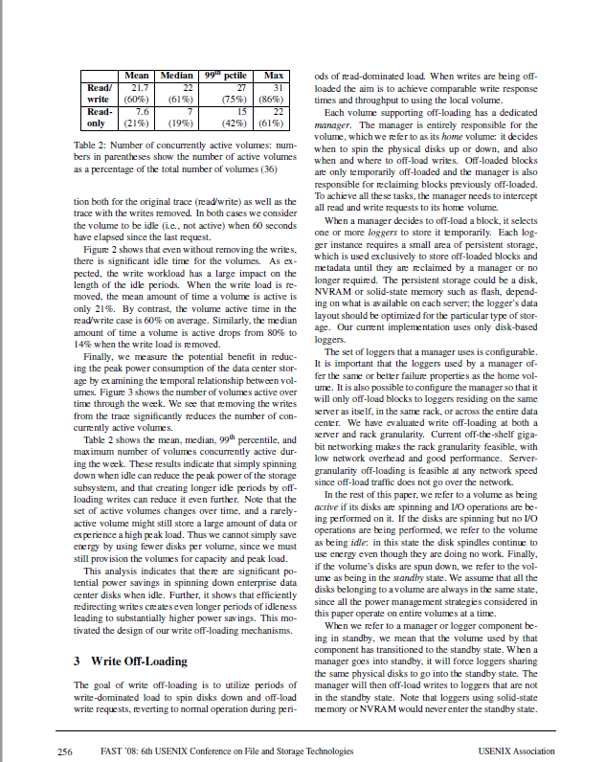
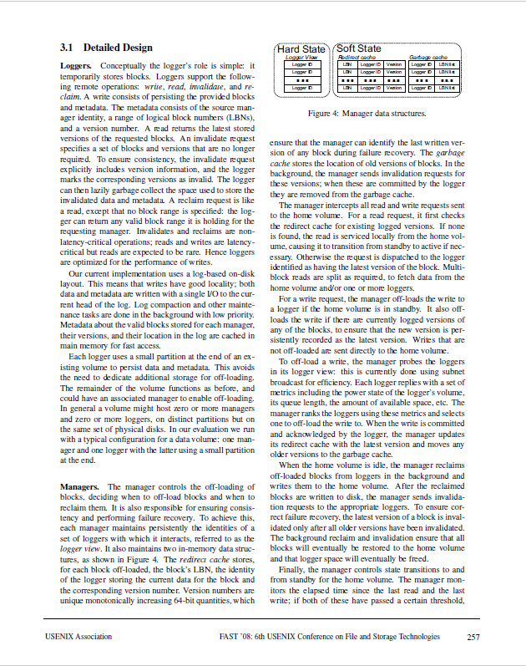
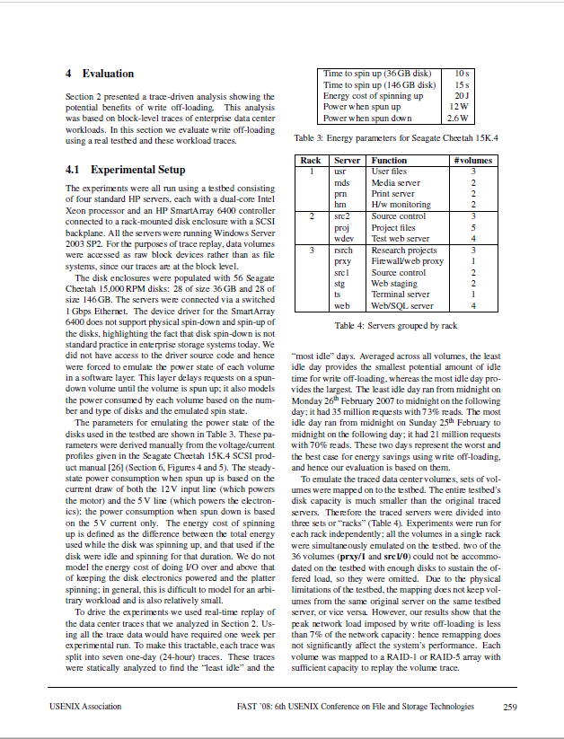
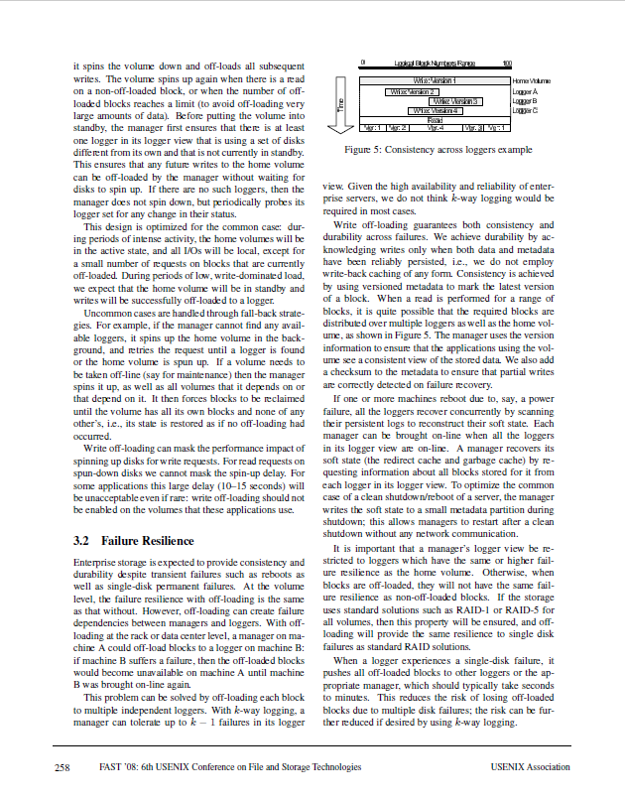
Write-off loading: Practical power Management for Enterprise Storage (FAST’08)
256 3. Write Off-Loading- 259p 4. Evaluation

